Slide 1

Sprint 1: Role-Based Task Management System
Presentation of the first sprint.
This sprint establishes core elements: authentication, authorization, and project/task creation.

Slide 2

Sprint 1 Focus Areas
Authentication Setup
Project/Task Creation
Docker Environments
Implementing Keycloak for secure user authentication.
Developing the initial project and task creation workflows.
Preparing Docker setups for consistent deployments.
This sprint lays the foundation for a role-based task management system.

Slide 3

Key Sprint Goals
Keycloak Setup
Install and configure Keycloak for identity management.
Authentication
Implement NextAuth for user login and session management.
Task Creation
Develop project and task creation interfaces and APIs.
Dockerize
Prepare Docker environments for consistent development.
RBAC logic via Keycloak and CASL is a goal.

Slide 4
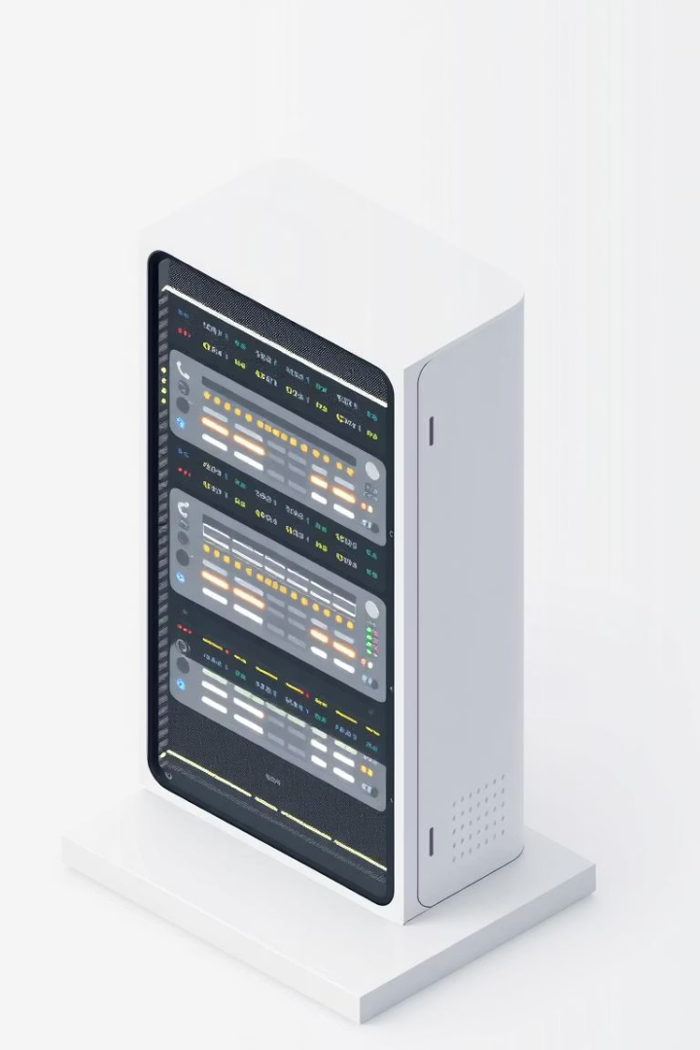
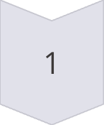
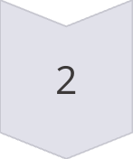
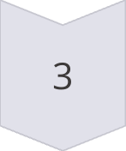
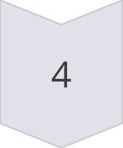
Keycloak Configuration
Install and Configure
Create Realms, Clients, Roles
(Admin, Manager, Employee)
Set Up Mappers
Include role information in JWT.
Role-Based Groups
Manage permission scalable.
We focused on setting up roles and permissions.

Slide 5





Authentication Flow
Integrate
Login Flow
Store Token
Keycloak with NextAuth.js
Redirect to Keycloak.
Store JWT in secure cookie.
Retrieve Roles
Apply them using CASL.
Securely managing authentication is crucial.

Slide 6
Project & Task Management UI
Project Creation Page
Task Creation Page
Name
Task name
Description
Description
Status
The UI allows project and task creation.

Slide 7



Docker Environment Setup
1
docker-compose.yml
2
Dockerfile
3
Dockerfile
The environment includes MongoDB, Keycloak, Backend API, and Frontend app.

Slide 8
Product Backlog (Sprint 1)
ID
Title
Description
Status
PB1
Setup Keycloak Server
Install and configure Keycloak with realms, clients, roles
PB2
Create User Roles in Keycloak
Define Admin, Manager, Employee, assign permissions
PB3
Create Test Users
Create sample users with each role
PB4
Integrate NextAuth with Keycloak
Setup frontend authentication using Keycloak OAuth2
PB5
Decode Roles from JWT
Extract roles from token and share via session in frontend
PB6
Setup MongoDB with Docker
Add MongoDB container to docker-compose
PB7
Dockerize NestJS Backend
Add Dockerfile for backend API
PB8
Dockerize Next.js Frontend
Add Dockerfile for frontend
PB9
Project Creation Page
UI and API integration to create new projects
PB10
Task Creation Page
UI and API integration to create new tasks linked to a project
PB11
CASL Integration (Frontend + Backend)
Use CASL to control UI visibility and API permissions
PB12
Initialize Frontend App
Create basic Next.js app with routing and layout setup
PB13
Initialize Backend App
Scaffold NestJS app with modules and MongoDB connection
All 13 tasks are complete for Sprint 1.

Slide 9
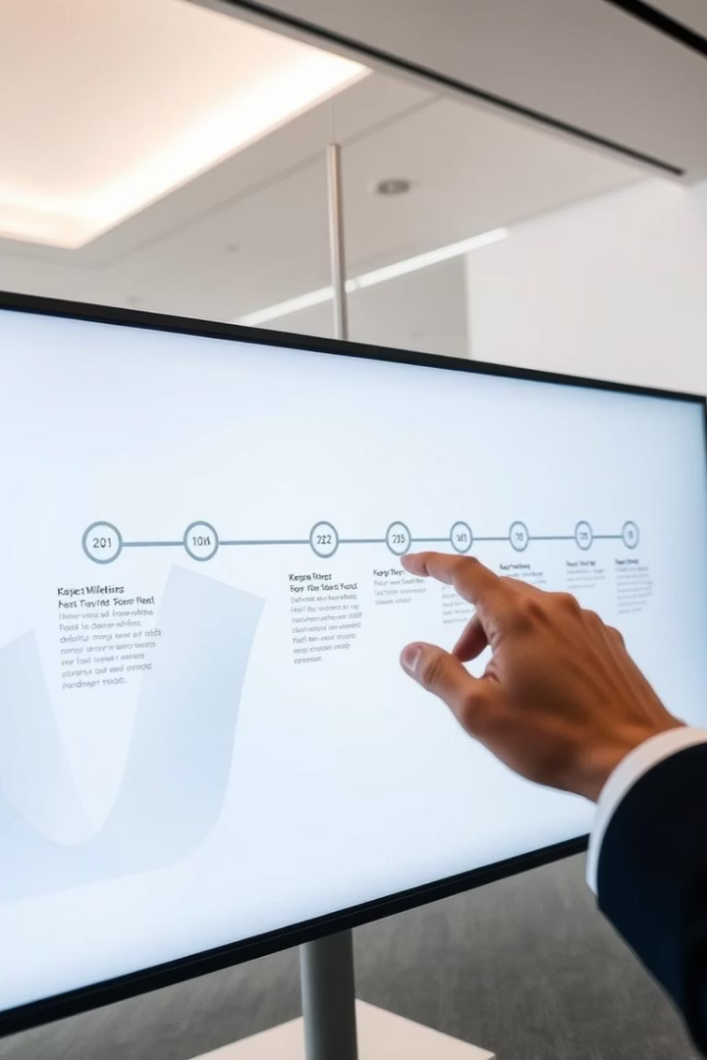
Timeline Overview
1
Week 1
Keycloak + Docker setup
Auth integration (Next.js + API)
2
Week 2
Project & Task modules
CASL permissions + Final testing
Each week was dedicated to a specific milestone.

Slide 10
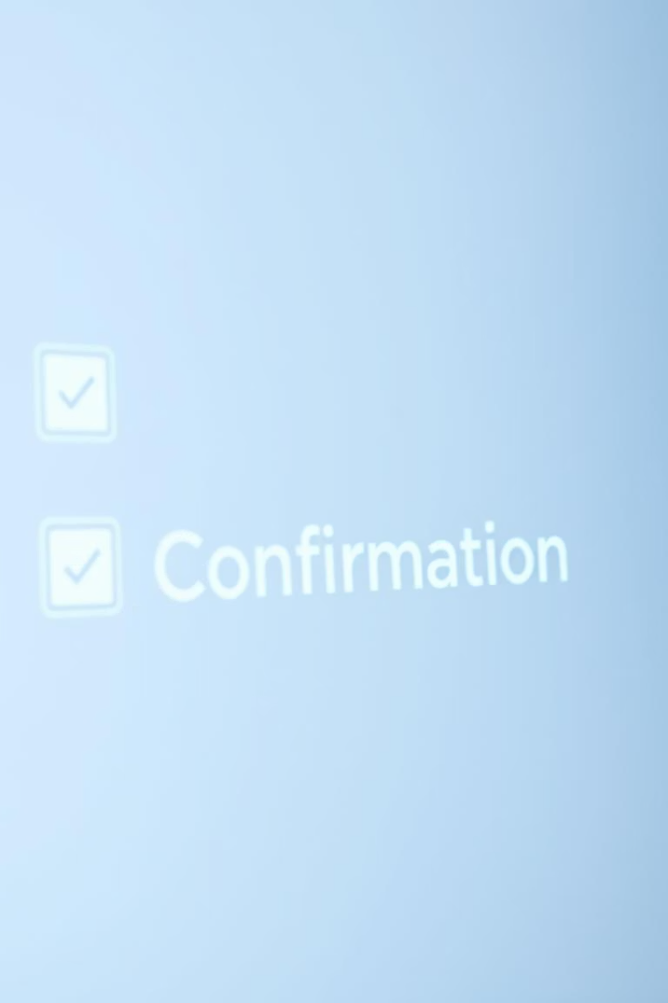




Sprint Deliverables
Working Keycloak Server
Secure Authentication
Project & Task Functionality
Dockerized Environment
We successfully delivered all goals.

